Slide 1
Magnetic Magic
MRI Synthesis Through Variable Field Strength
Rakesh chary Bangaroj 2290052
Kruthik Kalyanam 2285063

Slide 2
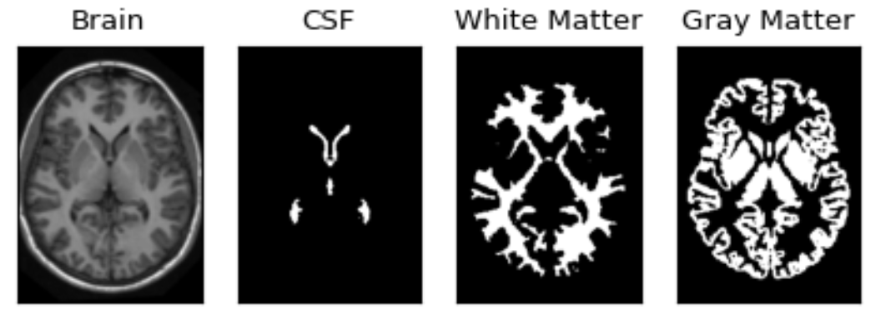
Synthetic MRI Image Simulation Using 3D OASIS Dataset
Objective: This project focuses on simulating Magnetic Resonance Imaging (MRI) at different magnetic field strengths (B0) using the 3D OASIS dataset. By leveraging tissuespecific maps, synthetic MRI images are generated to study the effects of varying imaging parameters.
Dataset Overview:
The OASIS (Open Access Series of Imaging Studies) dataset provides highquality 3D brain tissue maps.
Tissue types include:
White Matter (WM)
Gray Matter (GM)
Cerebrospinal Fluid (CSF)

Slide 3
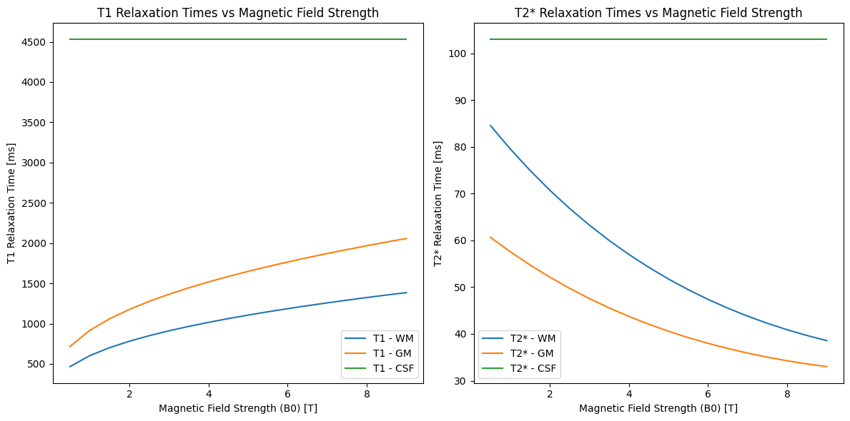
Signal Acquisition
The Signal Acquisition phase is a critical component of the MRI image synthesis project. It focuses on simulating T1weighted and T2weighted MRI images using prepared data and assessing how various imaging parameters influence the MRI signals of different brain tissues. This phase utilizes calculated relaxation times and SignaltoNoise Ratio (SNR) under various magnetic field strengths to derive practical insights into optimizing MRI protocols.

Slide 4
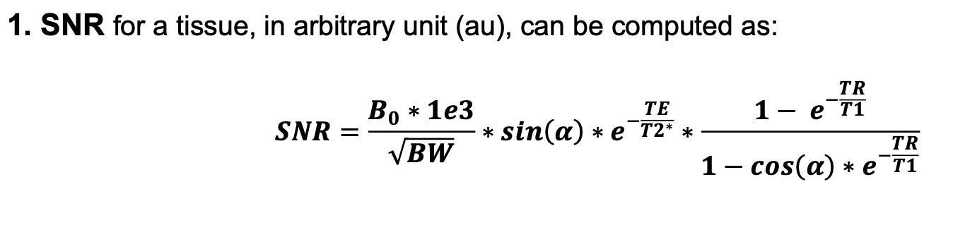
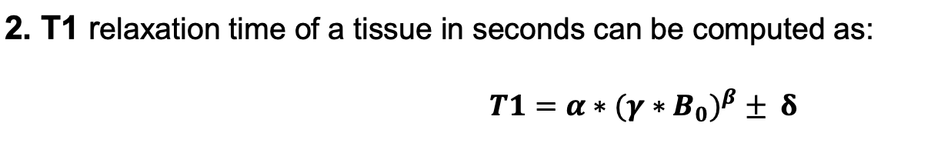
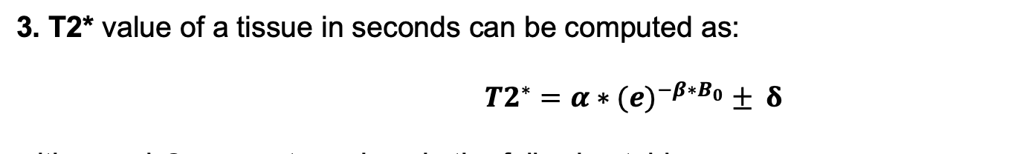
SNR Calculation
Where,
T1 relaxation time of a tissue in seconds

Slide 5
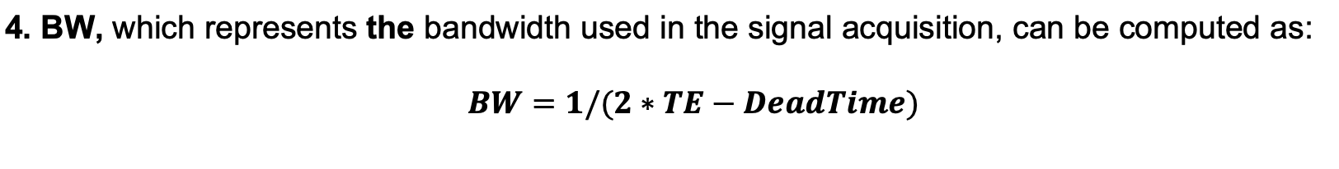
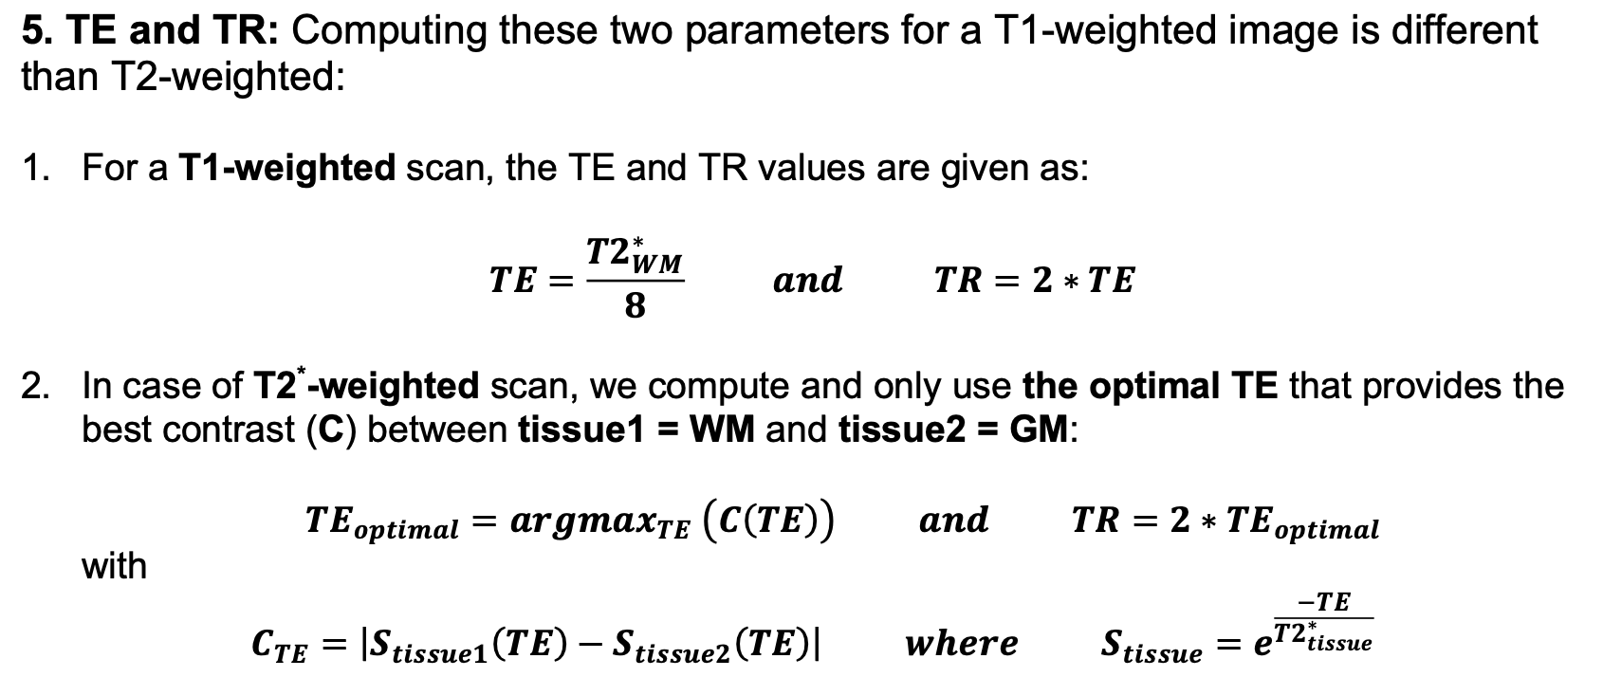

Slide 6
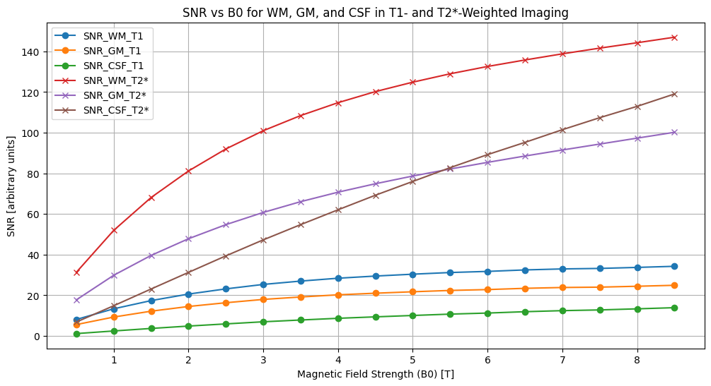
SNR vs B0 for WM, GM, and CSF in T1 and T2Weighted Imaging
1. T2Weighted Imaging:
SNR increases significantly with higher magnetic field strength (B0), with CSF showing the highest values due to its long relaxation times.
2. T1Weighted Imaging:
SNR remains relatively stable across the B0 range, with White Matter (WM) consistently having the highest SNR among tissues.
3. White Matter (WM):
Displays the highest SNR stability in T1weighted imaging and a steep SNR increase in T2weighted imaging at higher B0.
4. Cerebrospinal Fluid (CSF):
Shows the lowest SNR in T1weighted imaging but dominates in T2weighted imaging at higher magnetic fields.
5. Practical Implications:
T2weighted imaging benefits significantly from high B0 (e.g., 7T, 9T), while T1weighted imaging is more stable across varying field strengths.

Slide 7
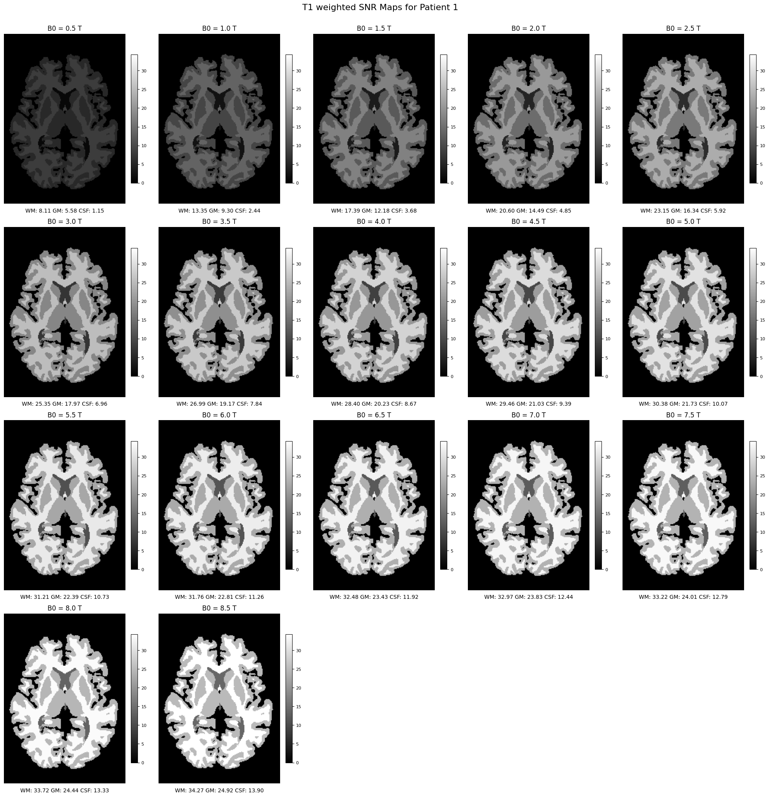
Plotting T1, T2 star SNR valued plots for Patient1 and Patient2
T1 weighted SNR plots for Patient 1
T1 weighting in SNR maps highlights tissue contrast based on T1 relaxation times, which represent the time protons take to realign with the magnetic field after excitation. This technique emphasizes tissues with shorter T1 times, such as White Matter (WM), which appears brightest in T1weighted maps, followed by Gray Matter (GM), while Cerebrospinal Fluid (CSF) appears darkest due to its long T1 time. T1weighted imaging is widely used for anatomical brain imaging and detecting structural abnormalities, as it provides high tissue contrast to distinguish between WM and GM effectively.

Slide 8
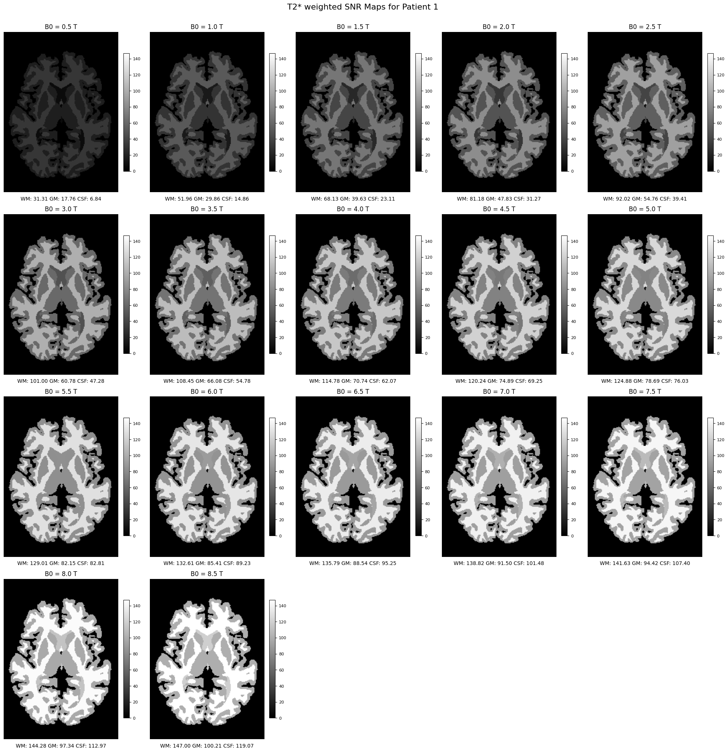
T2 weighted SNR plots for Patient 1
T2weighting in MRI emphasizes differences in transverse relaxation, combining natural T2 relaxation and dephazing caused by magnetic field inhomogeneities. It highlights tissues with longer T2 times, such as Cerebrospinal Fluid (CSF), which appear brighter, while tissues with shorter T2 times, like White Matter (WM), appear darker. T2weighted imaging is highly sensitive to subtle tissue changes, making it valuable for detecting abnormalities like microbleeds, iron deposits, or changes in blood oxygenation (used in functional MRI). This technique is particularly effective at higher magnetic field strengths (B0), providing enhanced tissue contrast and greater sensitivity for structural and functional imaging.

Slide 9
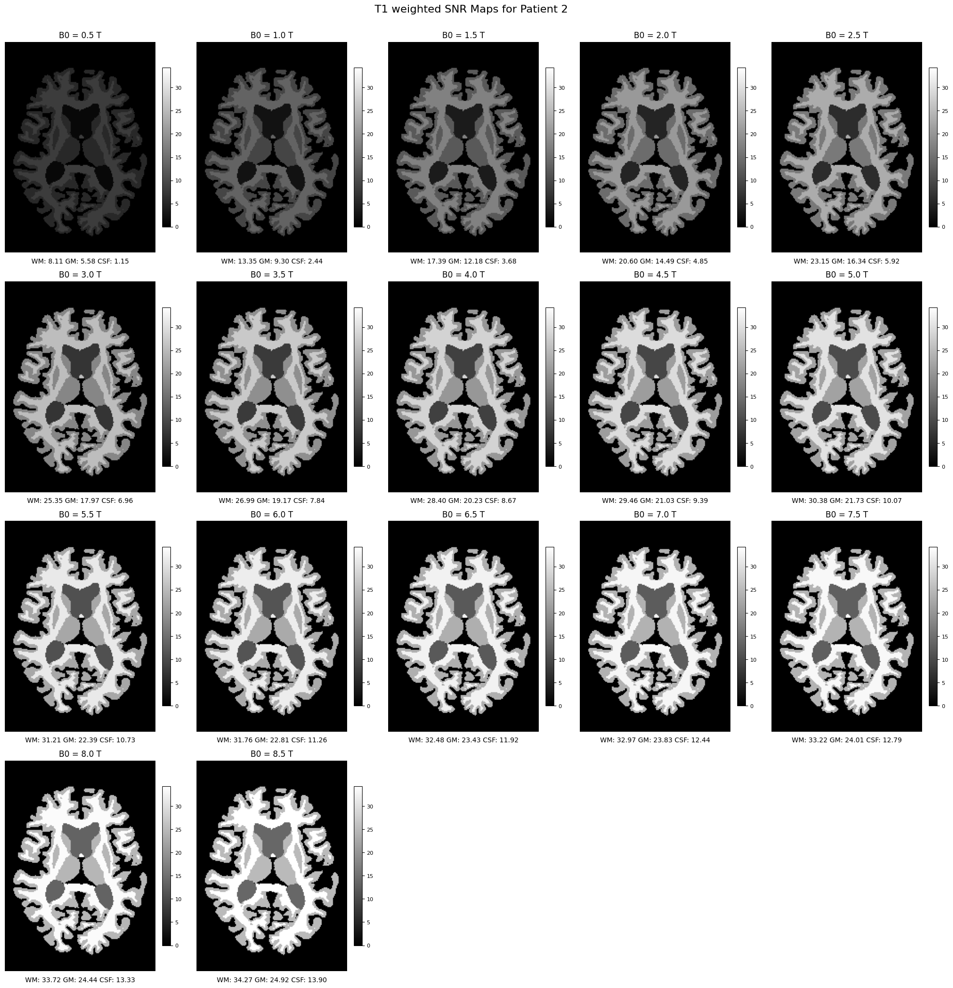
T1 weighted SNR plots for Patient 2
Steady SNR Increase with Magnetic Field Strength (B0):
Across all tissues (White Matter, Gray Matter, Cerebrospinal Fluid), the SNR progressively improves as the magnetic field strength increases from 0.5T to 9T.
White Matter (WM) shows the highest SNR values, followed by Gray Matter (GM), with Cerebrospinal Fluid (CSF) consistently lower.
Tissue Contrast Enhancement:
Higher B0 values result in greater differentiation between WM, GM, and CSF, improving the visibility and separation of brain structures.
CSF's Minimal Contrast at Lower B0:
At lower magnetic field strengths (e.g., 0.5T to 2T), CSF has a significantly lower SNR, making it less distinguishable. However, its SNR improves at higher fields.
White Matter Dominance:
WM maintains consistently higher SNR values throughout the range, indicating strong signal stability and contrast in T1weighted imaging.
Optimal Imaging at High B0:
SNR values at B0 ≥ 6T highlight substantial improvements in image quality and tissue contrast, making highfield MRI particularly advantageous for detailed structural analysis.

Slide 10
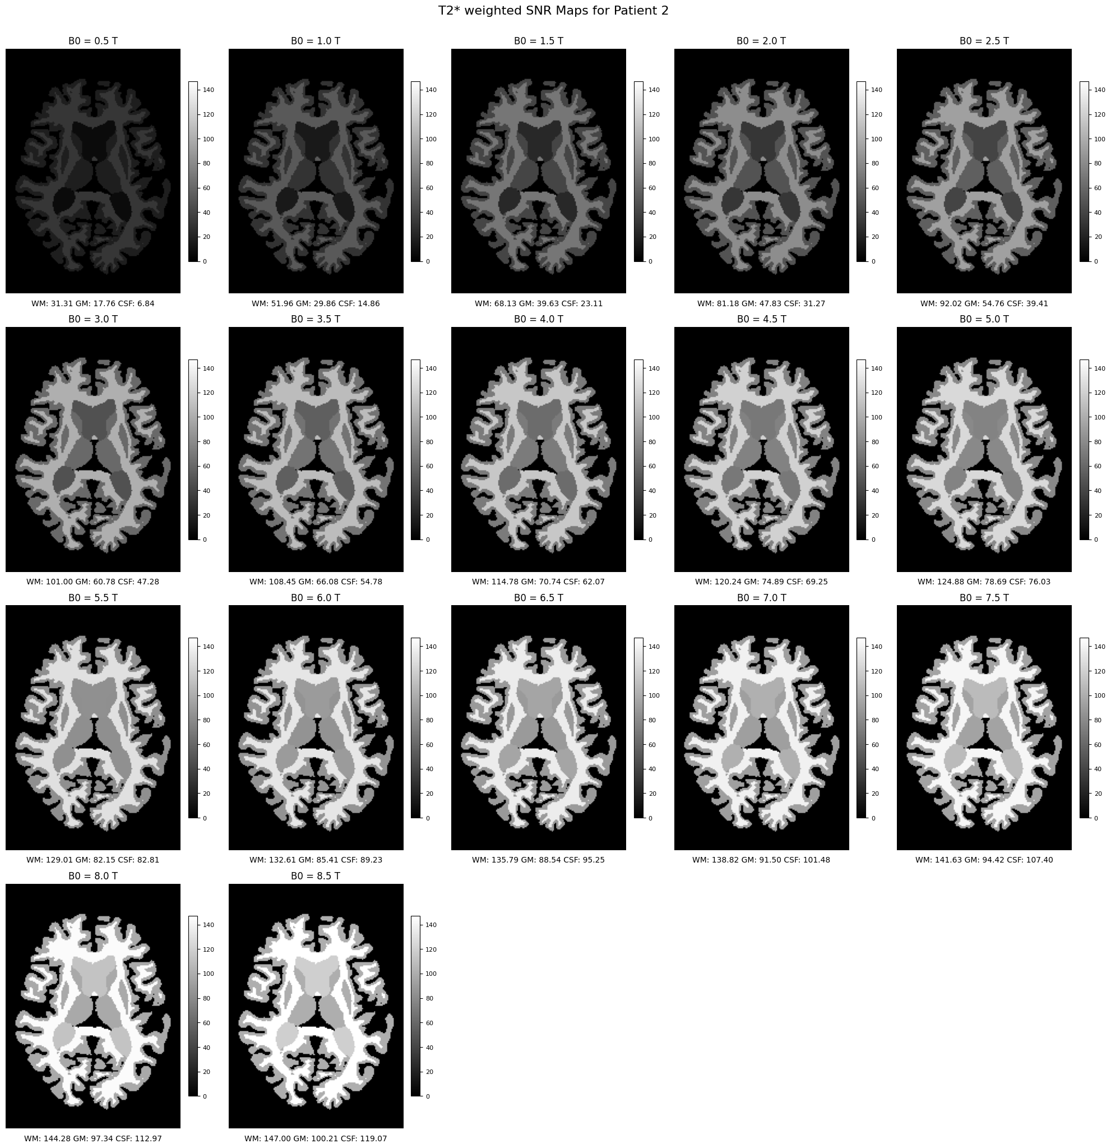
T2 weighted SNR plots for Patient 2
1. SNR Increase with Magnetic Field Strength (B0):
As B0 increases from 0.5T to 9T, the SNR for all tissues (WM, GM, CSF) rises significantly. For instance, WM SNR increases from 31.9 (at 0.5T) to 147.09 (at 9T), showing a strong dependence on field strength.
2. White Matter Dominance:
White Matter consistently exhibits the highest SNR, providing better contrast. At B0 = 5T, WM achieves 120.24, compared to GM (74.89) and CSF (69.25).
3. Enhanced CSF Contrast at Higher B0:
Cerebrospinal Fluid's SNR increases rapidly at higher fields due to its long T2 relaxation, reaching 112.97 at 8T, making it more distinguishable in highfield imaging.
4. Practical HighField MRI Advantages:
Field strengths above 6T deliver substantial SNR gains for all tissues, supporting their use for detailed structural imaging, especially in clinical and research settings.

Slide 11
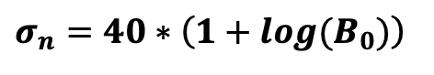
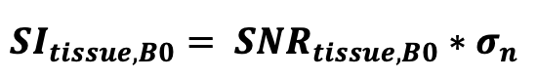
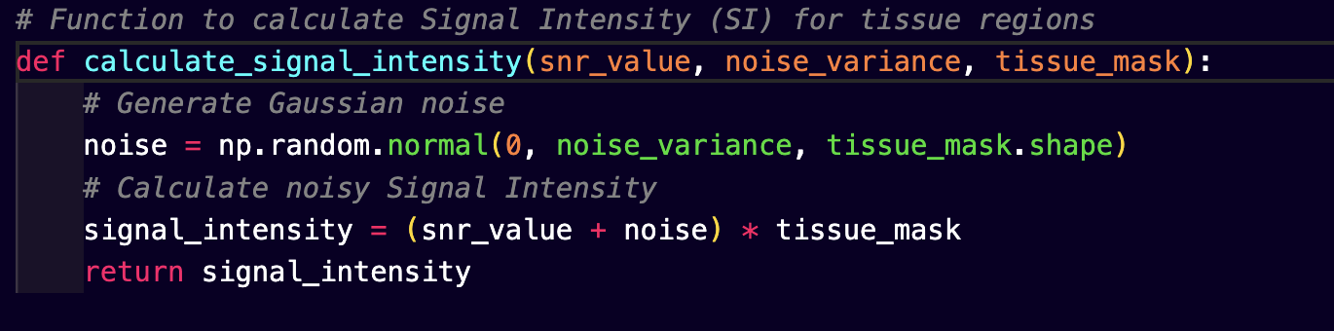
Noise Addition for Realworld image simulation
Gaussian Noise Generation:
Noise is simulated as Gaussian noise with a variance, dependent on the magnetic field strength (B0 )
the Signal Intensity (SI) can be computed by:

Slide 12
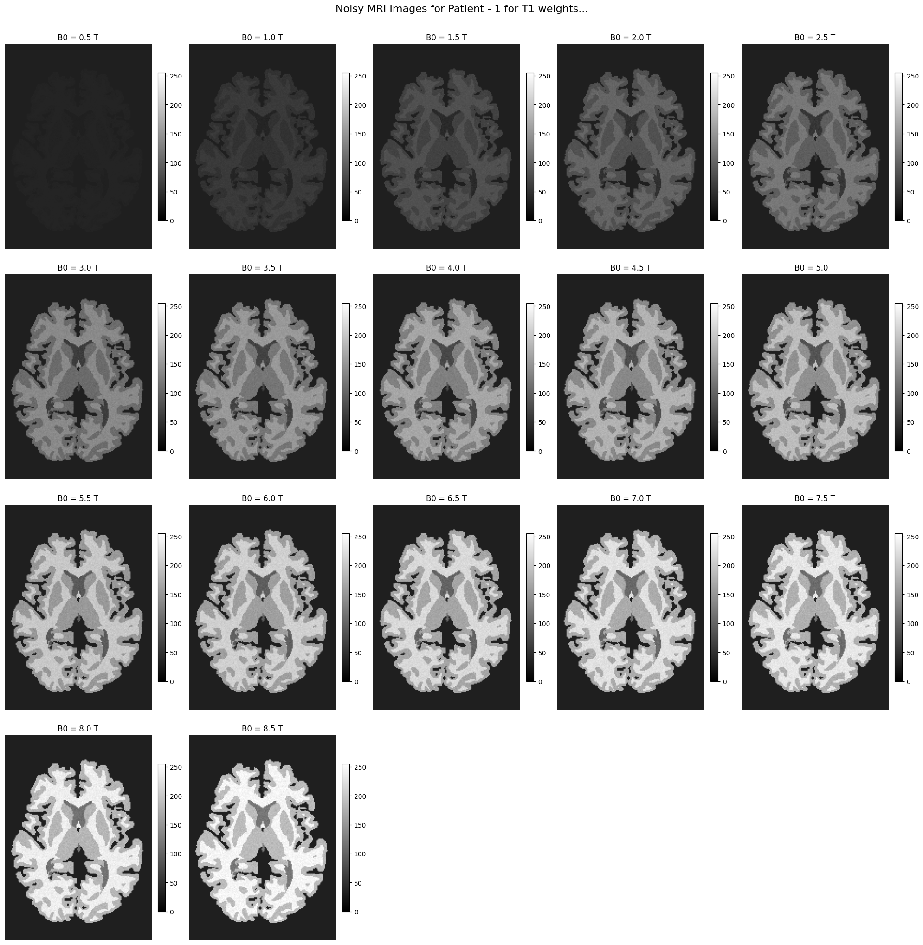
Noisy MRI images for Patient 1 for T1 weights
1. Impact of Noise at Low ( B0):
At lower magnetic field strengths (( B0 = 0.5T ) to ( 2T )), noise significantly reduces the image quality.
The images appear darker with reduced contrast, making it difficult to differentiate between tissues like WM, GM, and CSF.
2. Progressive Image Clarity with Higher ( B0 ):
As ( B0 ) increases beyond ( 3T ), the noise effects become less prominent due to higher SNR values.
Tissue boundaries and structural details become more distinguishable.
3. Optimal Image Quality at High (B0):
At ( B0 = 6T) and above, the images show excellent tissue contrast and minimal noise effects.
White Matter (WM) appears brightest, followed by Gray Matter (GM) and Cerebrospinal Fluid (CSF), consistent with T1weighted imaging characteristics.
4. Noise Variance vs Field Strength:
Noise variance increases with (B0), but higher SNR compensates for the added noise, improving overall image quality at higher fields.
5. Practical Implications:
High field MRI (B0 >= 6T ) provides superior image quality despite increased noise levels, making it ideal for applications requiring detailed structural visualization.

Slide 13
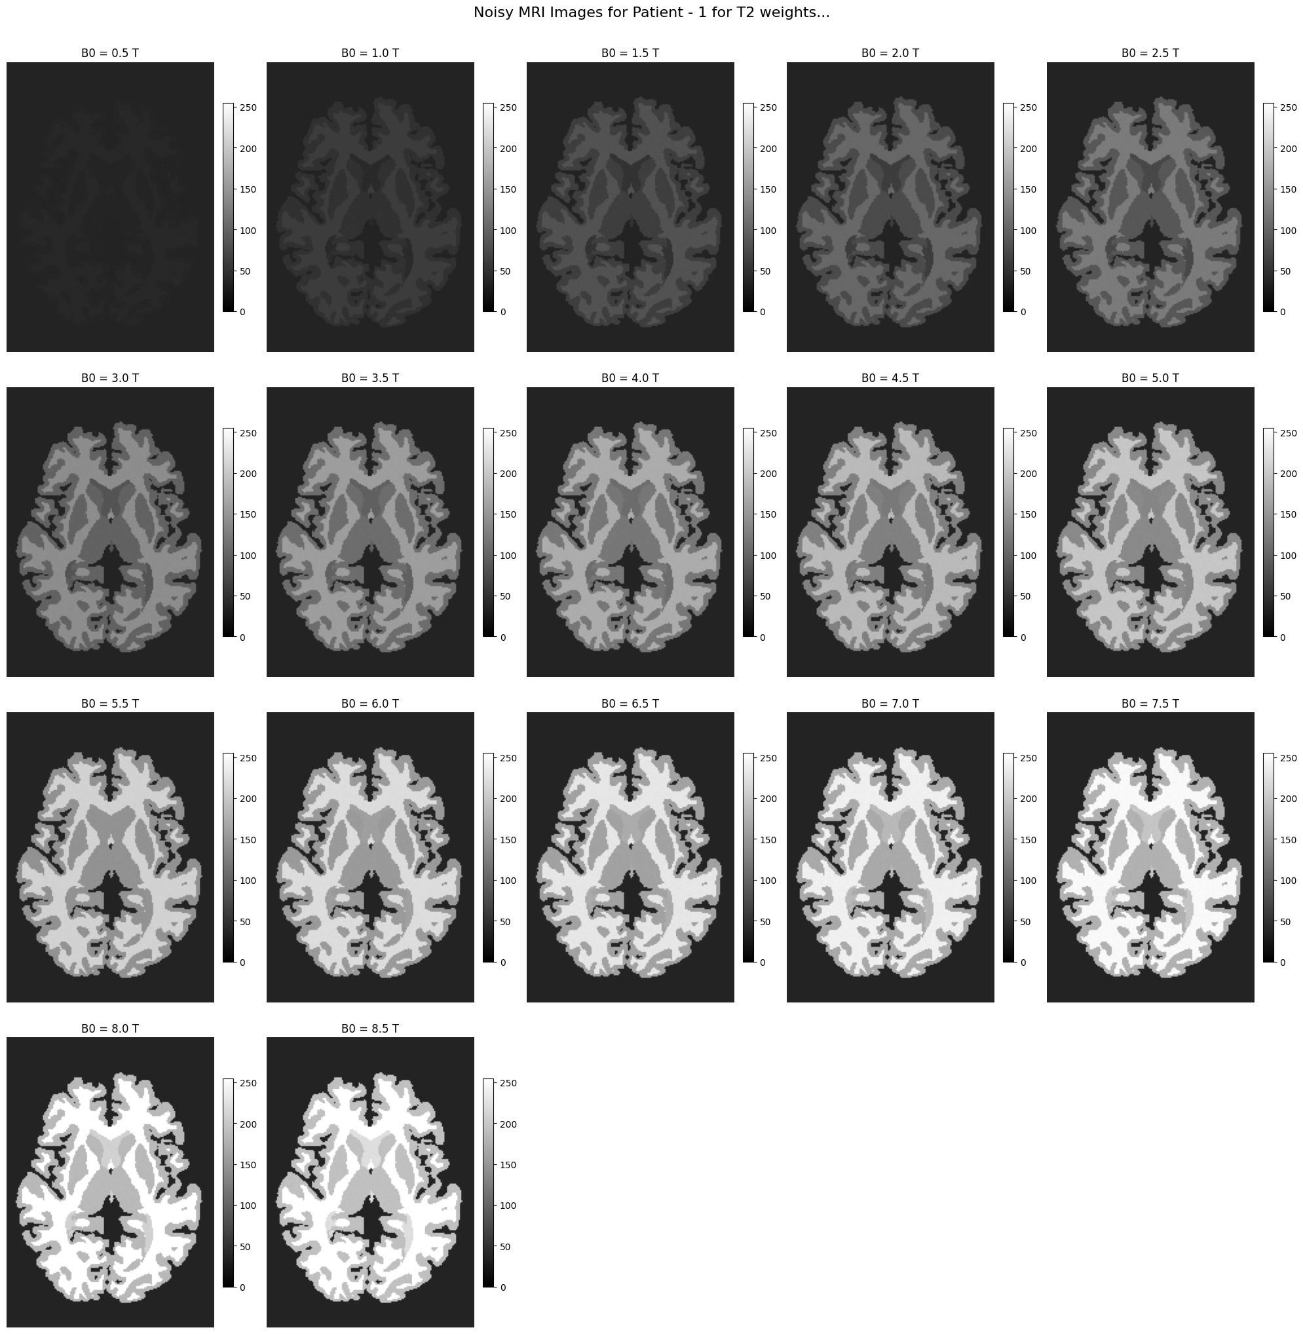
Noisy MRI images for Patient 1 for T2 weights
1. Noise Impact at Low ( B0 ):
At lower magnetic field strengths (( B0 = 0.5T ) to ( 2T )), the images are heavily influenced by noise, leading to poor tissue visibility and contrast.
Structural details of White Matter (WM), Gray Matter (GM), and Cerebrospinal Fluid (CSF) are barely distinguishable.
2. Improved Clarity with Increasing ( B0 ):
As ( B0 ) increases beyond ( 3T ), the SignaltoNoise Ratio (SNR) improves, leading to clearer tissue boundaries.
By ( B0 = 4T ), WM and GM are more distinguishable, and CSF begins to gain visibility.
3. Optimal Image Quality at High ( B0 ):
At higher field strengths (( B0 >= 6T )), noise effects are less significant due to higher SNR values.
T2weighted imaging highlights CSF with increased brightness, while WM and GM maintain strong contrast.
4. Tissue Differentiation:
CSF, which has a longer T2 relaxation time, becomes the most prominent tissue at high ( B0 ), followed by GM and WM
The images clearly demonstrate the dominance of CSF brightness in T2weighted imaging at ( B0 >= 7T ).
5. Noise Variance vs Field Strength:
Although noise variance increases with ( B0 ), the improved SNR compensates for this, resulting in significantly better image quality at higher magnetic field strengths.

Slide 14
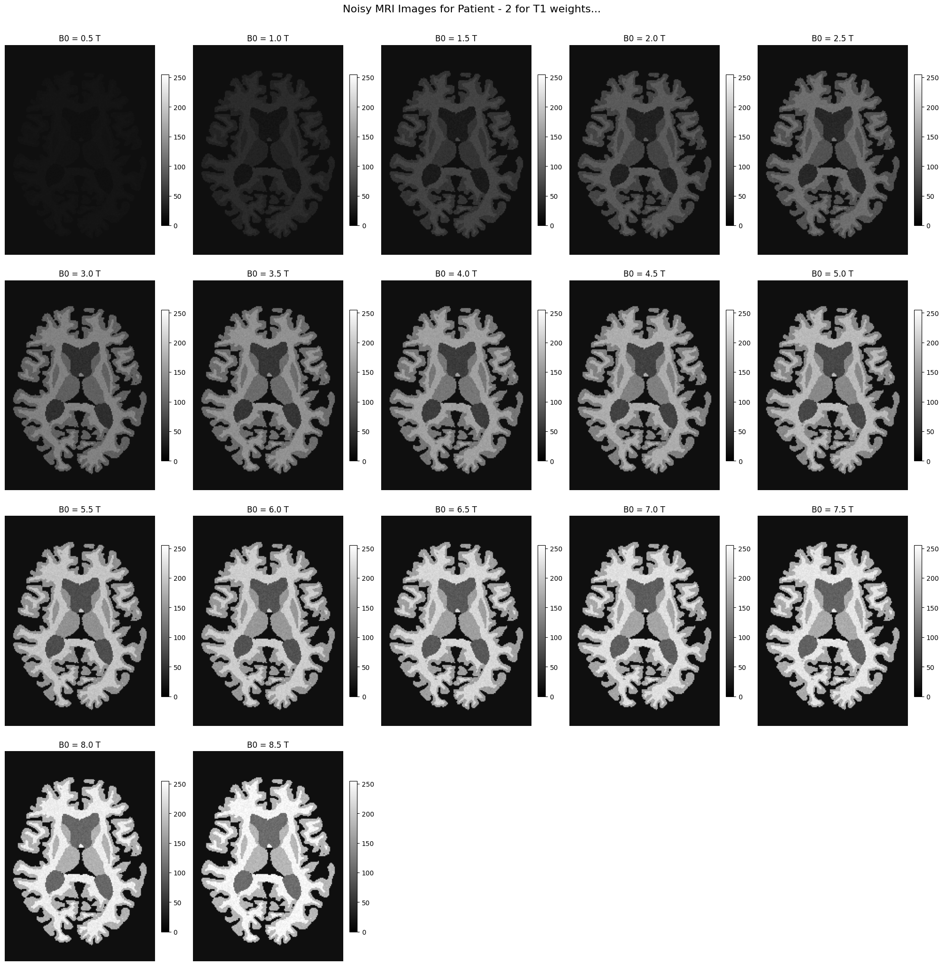
Noisy MRI images for Patient 2 for T1 weights
1. Noise Suppression at Higher ( B0 ):
At lower magnetic field strengths (( B0 = 0.5T ) to ( 2T )), the images are dark and heavily affected by noise, making tissue boundaries indistinguishable.
As ( B0 ) increases beyond ( 3T ), the SignaltoNoise Ratio (SNR) improves, leading to clearer images with better contrast.
2. Tissue Contrast Enhancement:
White Matter (WM) remains the brightest tissue across all ( B0 ) values, followed by Gray Matter (GM) and Cerebrospinal Fluid (CSF).
At ( B0 >= 5T ), distinct boundaries between WM, GM, and CSF become visible.
3. Optimal Clarity at High ( B0 ):
At ( B0 >= 6T ), noise effects are minimal, and tissue differentiation is excellent. WM and GM are clearly distinguishable, while CSF appears consistently darker due to its long T1 relaxation time.
4. Improved SNR vs Noise Variance:
The noise variance increases logarithmically with ( B0 ), but higher SNR compensates for this effect, improving image quality at high magnetic field strengths.
5. Applications of HighField Imaging:
The images at ( B0 = 7T ) and above demonstrate the potential of highfield MRI for accurate anatomical imaging and detailed visualization of brain structures.

Slide 15
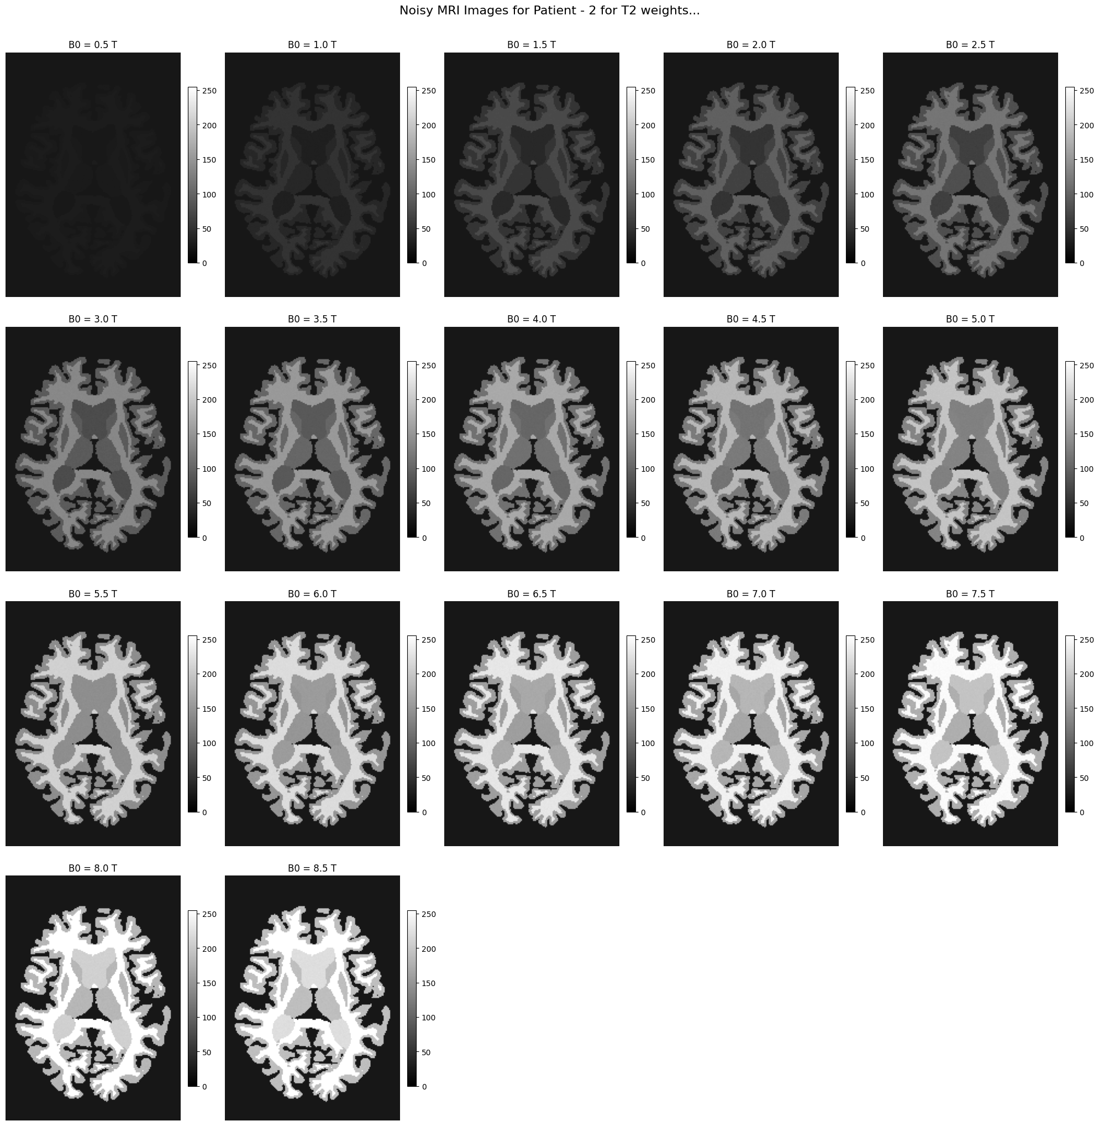
Noisy MRI images for Patient 2 for T2 weights
1. Noise Prominence at Low ( B0 ):
At low field strengths (( B0 = 0.5T ) to ( 2T )), the images are heavily influenced by noise, resulting in poor tissue contrast and limited visibility of structural details.
CSF, GM, and WM boundaries are indistinct due to the dominance of noise over signal intensity.
2. Improved SNR with Increasing ( B0 ):
As ( B0 ) increases beyond ( 3T ), noise becomes less impactful due to a stronger SNR, leading to better tissue contrast and clearer visualization of WM, GM, and CSF.
3. CSF Brightness in High ( B0 ):
At ( B0 >= 6T ), CSF becomes significantly brighter compared to WM and GM, reflecting its longer T2 relaxation time. This highlights the sensitivity of T2weighted imaging to CSF at high magnetic field strengths.
4. Optimal Image Quality at ( B0 >= 7T ):
Highfield imaging at ( B0 = 7T ) and ( 8.5T ) offers excellent tissue contrast, with WM, GM, and CSF clearly distinguishable. CSF appears the brightest, followed by GM and WM.
5. Clinical Implications of High ( B0 ):
Highfield MRI minimizes noise effects and enhances tissue differentiation in T2weighted imaging, making it ideal for detecting subtle structural changes and tissue abnormalities.

Slide 16
MRI Resolution
Objective:
To modify the spatial resolution and slice thickness of MRI data for better simulation and analysis of image quality, contrast, and SNR (SignaltoNoise Ratio).
Methodology:
1. Initial Data Structure:
The noisy MRI data for two patients (Patient 1 and Patient 2) was stored at (B0 = 3T) for T1and T2weighted imaging.
Original resolution: 1mm isotropic slices with a shape of ( (160, 192, 224) ).
2. Resampling:
The original isotropic resolution was resampled into:
Inplane resolution: 1mm × 1mm and 2mm × 2mm.
Slice thickness: 1mm, 2mm, 5mm, and 10mm.
Implemented resampling functions to adjust voxel sizes while maintaining anatomical integrity.
3. Resulting Resampled Structure:
Resampled resolutions for both patients include various combinations:
( 1mm times 1mm ): ( (160, 192, 224) ), ( 1mm times 2mm ): ( (160, 96, 224) ), and so on.
Example for T1weighted: At ( 2mm times 2mm ) resolution with 5mm slice thickness, the shape is ( (80, 38, 112) ).
5. Impact of Resampling:
Image Quality: Higher resolutions retain finer details but have larger data sizes.
SNR: Thicker slices and lower inplane resolutions reduce SNR, leading to degraded image quality.
How This Solution Was Achieved:
1. Loaded noisy MRI data for T1 and T2 modalities for each patient at (B0 = 3T).
2. Developed resampling functions to adjust spatial resolution:
For slice thickness, resampled along the zaxis.
For inplane resolution, resampled along xand yaxes.
3. Stored results in a structured format to capture all combinations of resolutions and slice thicknesses.
4. Verified resampling by comparing shapes and visualizing resultant MRI images for all combinations.
This process allowed us to simulate realistic changes in MRI resolution and analyze their impact on SNR and image quality effectively. Let me know if you'd like to elaborate on any specific step!
How This Solution Was Achieved:
Loaded noisy MRI data for T1 and T2 modalities for each patient at (B0 = 3T).
2. Developed resampling functions to adjust spatial resolution:
For slice thickness, resampled along the zaxis.
For inplane resolution, resampled along x and yaxes.
3. Stored results in a structured format to capture all combinations of resolutions and slice thicknesses.
4. Verified resampling by comparing shapes and visualizing resultant MRI images for all combinations.
This process allowed us to simulate realistic changes in MRI resolution and analyze their impact on SNR and image quality effectively. Let me know if you'd like to elaborate on any specific step!

Slide 17
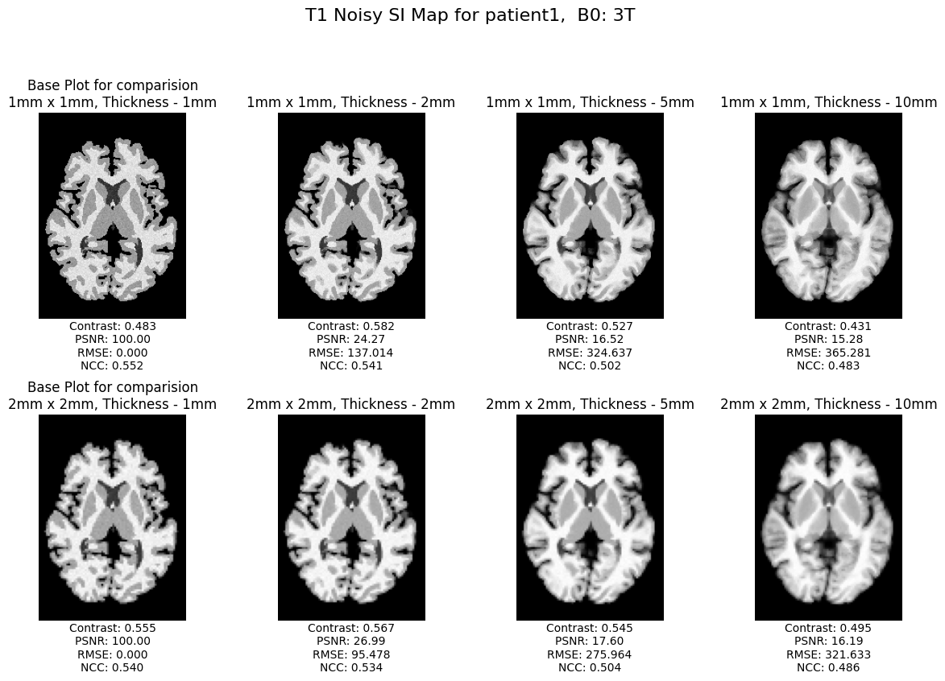
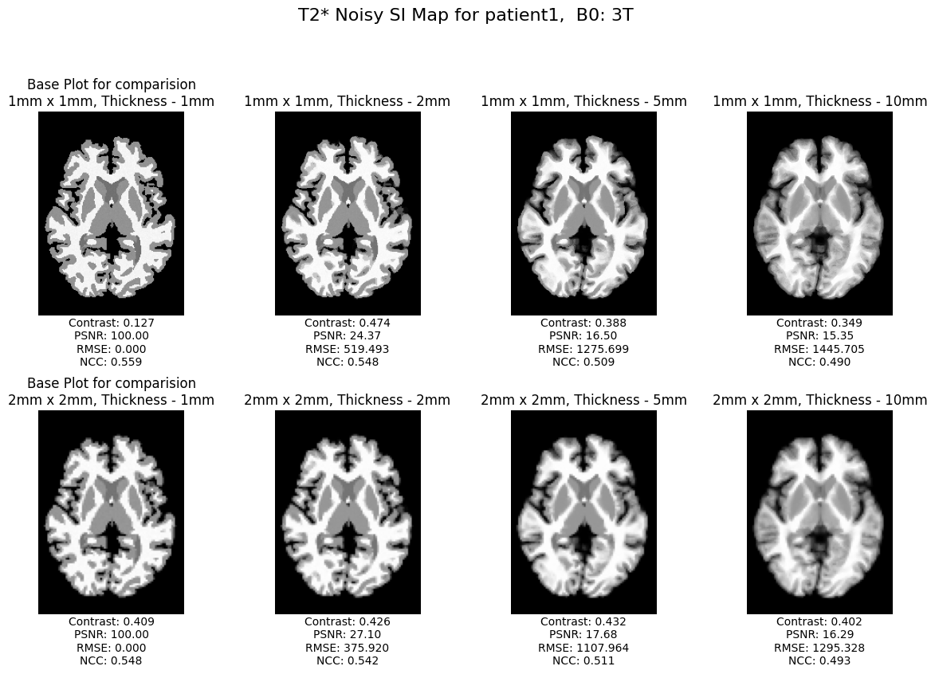
T1 and T2 Noisy SI maps for Patient 1 at B0 = 3T

Slide 18
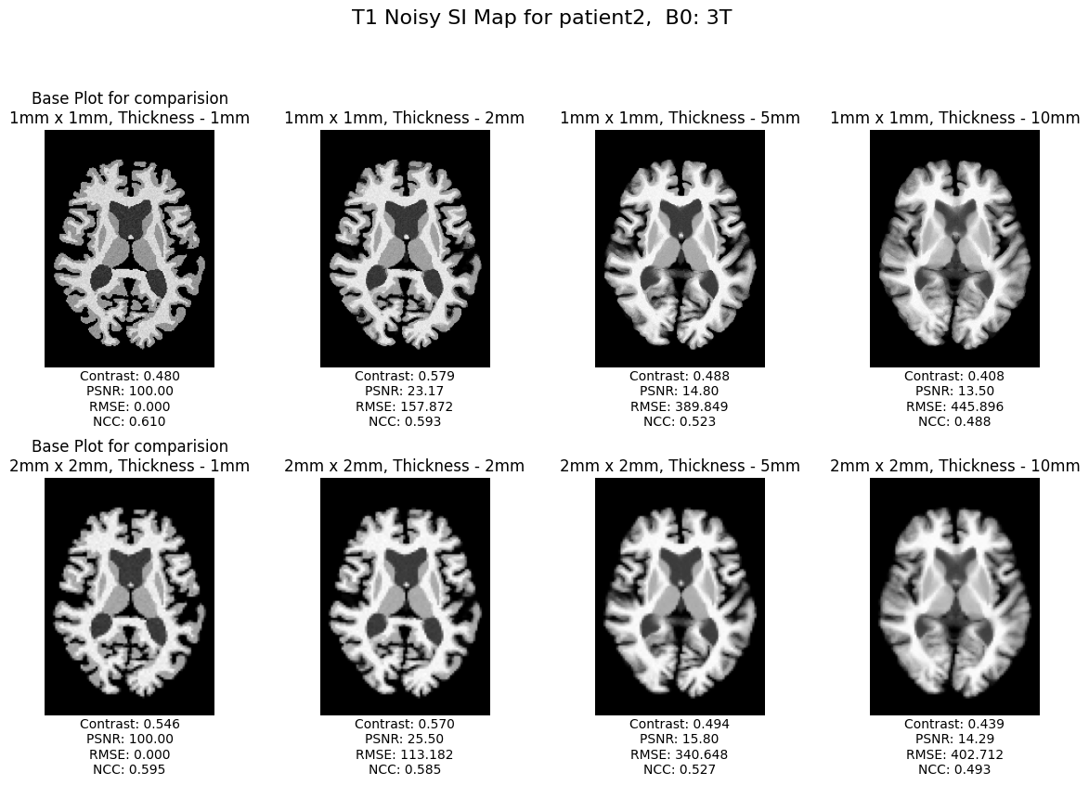
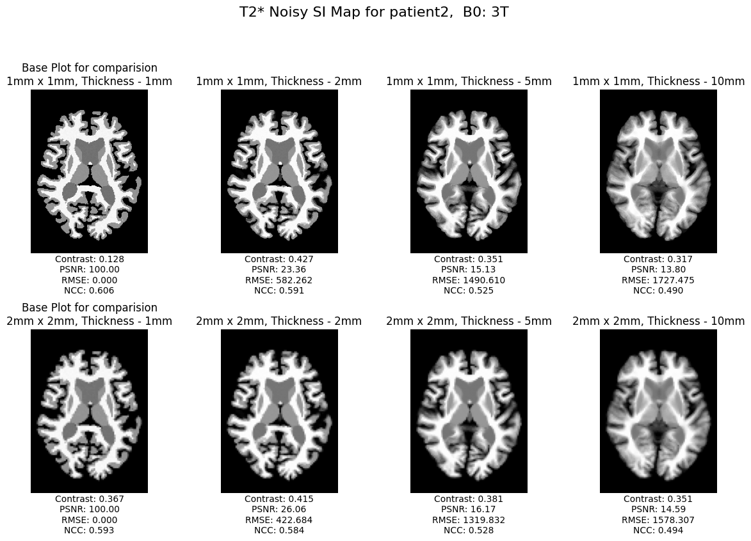
T1 and T2 Noisy SI maps for Patient 2 at B0 = 3T

Slide 19
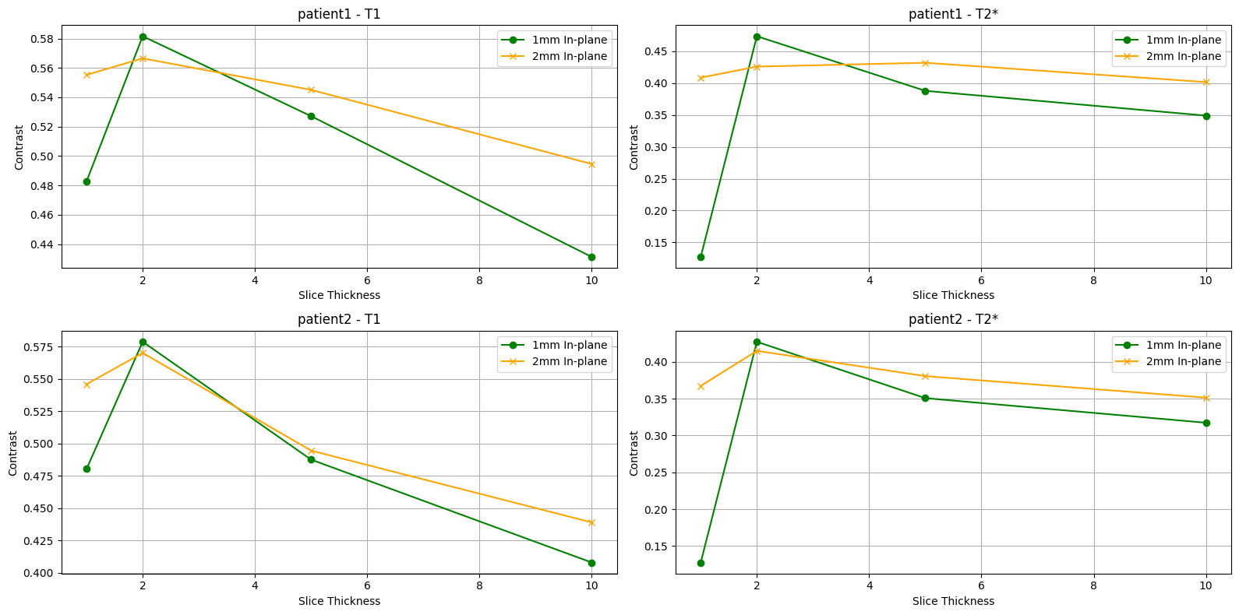
Metrics Analysis: Comparing Contrast for different thickness for Patient1 and Patient2
PatientSpecific Insights:
Patient 1 T1 Weighted:
Contrast peaks at 2mm slice thickness for both inplane resolutions and declines steadily with further thickness increases.
At 10mm slice thickness, the contrast drops to around 0.48 for 1mm inplane and 0.52 for 2mm inplane.
Patient 1 T2Weighted:
T2weighted images follow a similar trend, with the highest contrast observed at 2mm slice thickness.
For 10mm slice thickness, the contrast reduces to approximately 0.3 for 1mm inplane and 0.35 for 2mm inplane.
Patient 2 T1 Weighted:
Similar to Patient 1, contrast peaks at 2mm slice thickness, with 0.58 for 1mm inplane and 0.56 for 2mm inplane.
Contrast reduces significantly at 10mm slice thickness, reaching 0.48 for 1mm inplane and 0.50 for 2mm inplane.
Patient 2 T2Weighted:
T2weighted contrast is lower compared to T1weighted images.
At 10mm slice thickness, contrast drops to approximately 0.2 for 1mm inplane and 0.25 for 2mm inplane.

Slide 20
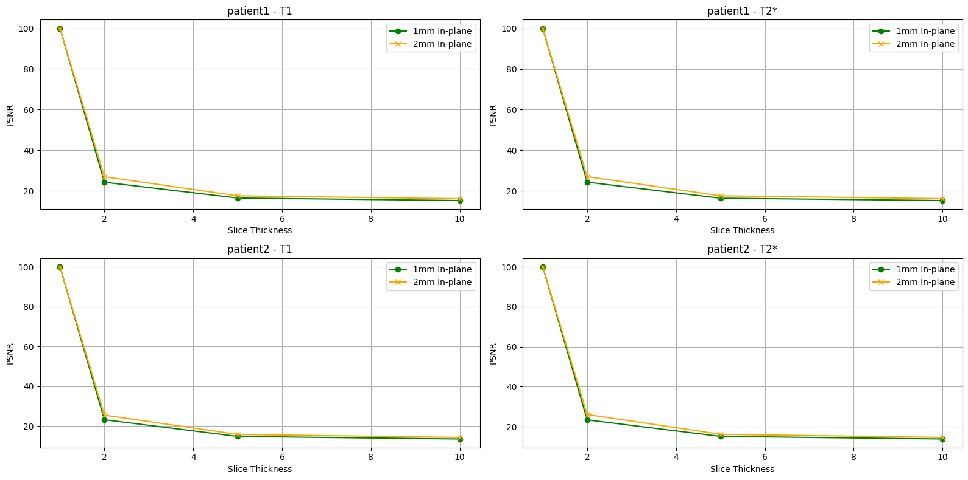
Metrics Analysis: Comparing Peak SignaltoNoise Ratio (PSNR)
for different thickness for Patient1 and Patient2
PatientSpecific Insights:
Patient 1 T1 Weighted:
The PSNR drops steeply from 100 dB at 2mm slice thickness to approximately 20 dB at 10mm slice thickness.
This indicates a significant degradation of signal clarity as slices become thicker.
Patient 1 T2Weighted:
The PSNR trend is similar to T1weighted imaging, with a sharp initial drop.
At 10mm slice thickness, the PSNR stabilizes around 20 dB, indicating consistent noise levels across slice thicknesses.
Patient 2 T1 Weighted:
Follows a similar trend to Patient 1, with PSNR dropping sharply after 2mm slice thickness.
PSNR at 10mm thickness is slightly higher than T2weighted images, showing better resilience to noise in T1weighted imaging.
Patient 2 T2Weighted:
T2weighted PSNR follows the same sharp decline as other plots, with values converging around 20 dB at 10mm slice thickness.

Slide 21
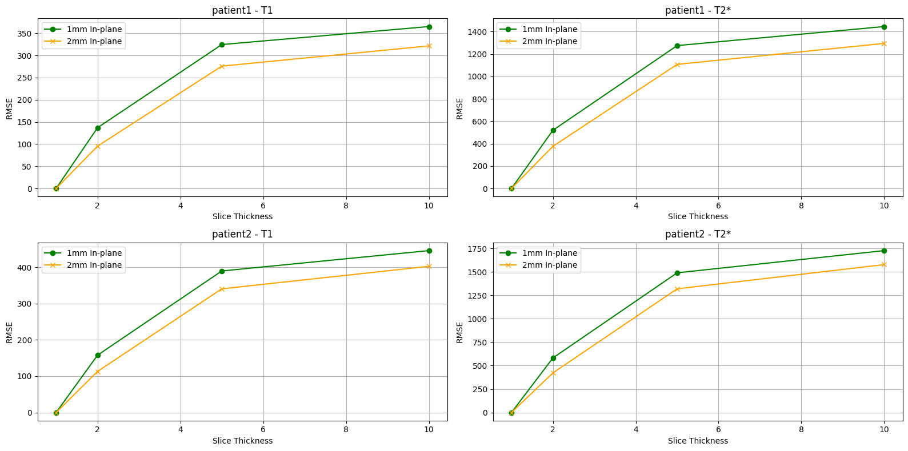
Metrics Analysis: Comparing Root Mean Square Errors(RMSE)
for different thickness for Patient1 and Patient2
PatientSpecific Insights:
Patient 1 T1 Weighted:
RMSE increases from ~50 at 2mm slice thickness to approximately 350 at 10mm slice thickness for 1mm inplane resolution.
The 2mm inplane resolution shows a lower increase, stabilizing around 300 at 10mm slice thickness.
Patient 1 T2Weighted:
T2weighted images exhibit a steeper rise in RMSE compared to T1weighted images.
RMSE reaches approximately 1400 at 10mm slice thickness for 1mm inplane resolution and 1200 for 2mm inplane resolution.
Patient 2 T1 Weighted:
RMSE trends are consistent with Patient 1, with values reaching 400 (1mm inplane) and 300 (2mm inplane) at 10mm slice thickness.
Patient 2 T2Weighted:
RMSE increases more dramatically, reaching approximately 1750 (1mm inplane) and 1500 (2mm inplane) at 10mm slice thickness.

Slide 22
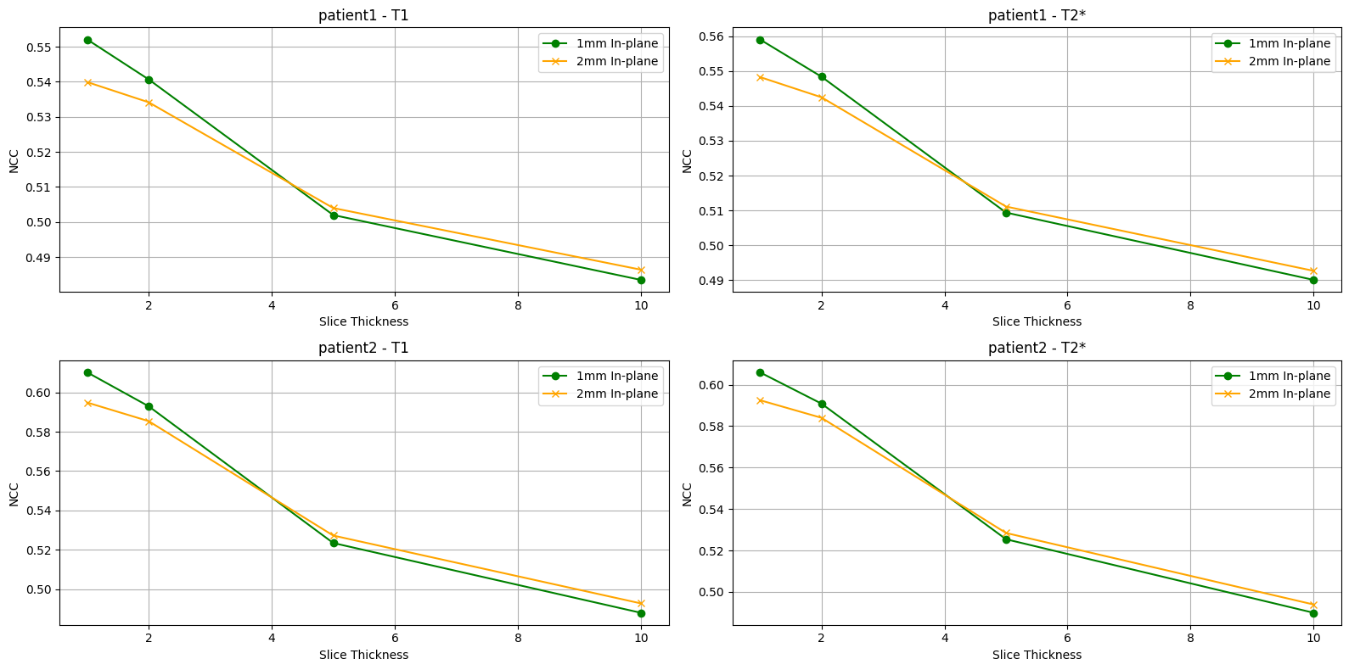
Metrics Analysis: Comparing Normalized CrossCorrelation (NCC) for different thickness for Patient1 and Patient2
PatientSpecific Insights:
Patient 1 T1 Weighted:
NCC starts at 0.55 (1mm inplane) and 0.54 (2mm inplane) at 2mm slice thickness.
By 10mm slice thickness, NCC drops to approximately 0.49 for both resolutions, reflecting a significant loss in correlation.
Patient 1 T2Weighted:
T2weighted images exhibit slightly lower NCC values than T1weighted images.
NCC decreases from 0.56 (1mm inplane) at 2mm slice thickness to 0.49 (both resolutions) at 10mm slice thickness.
Patient 2 T1 Weighted:
NCC starts higher at 0.60 (1mm inplane) and 0.58 (2mm inplane) for 2mm slice thickness.
By 10mm slice thickness, NCC reduces to approximately 0.50 for both resolutions, following a similar trend to Patient 1.
Patient 2 T2Weighted:
T2weighted NCC decreases from 0.58 (1mm inplane) and 0.57 (2mm inplane) at 2mm slice thickness, stabilizing around 0.50 at 10mm slice thickness.

Slide 23
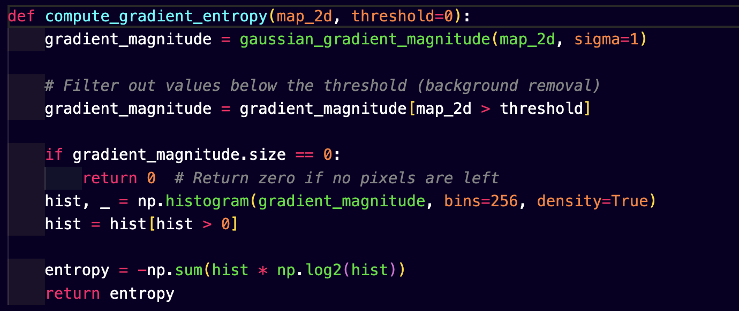
Metrics Analysis for different B0 values
Gradient Entropy
Gradient Entropy quantifies the randomness or variability in intensity gradients within an image, providing insight into the preservation of edges and textures. It is calculated by first determining the gradient magnitudes using edgedetection techniques like Sobel or Prewitt filters. These magnitudes are then normalized into a probability distribution, and the entropy is computed as the sum of
pi (log (pi))
represents the probability of each gradient magnitude. Higher gradient entropy values signify more complexity and detail in the image, while lower values indicate smoother or blurred regions. This metric is particularly sensitive to changes in image sharpness and can effectively measure the impact of resampling, noise, or resolution variations.
Applications: Gradient entropy is extensively used in image processing and MRI analysis to evaluate structural detail preservation and sharpness. It helps identify the degradation of image quality caused by resampling, noise addition, or increased slice thickness. Clinically, it supports the optimization of imaging parameters by quantifying the clarity of anatomical structures, which is critical for diagnostics. In advanced imaging techniques, gradient entropy can assist in validating machine learning models for image reconstruction or enhancement, ensuring the fidelity of generated outputs to original scans.

Slide 24
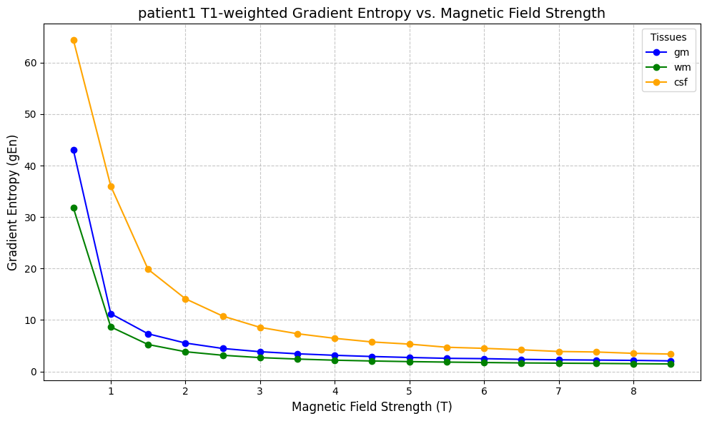
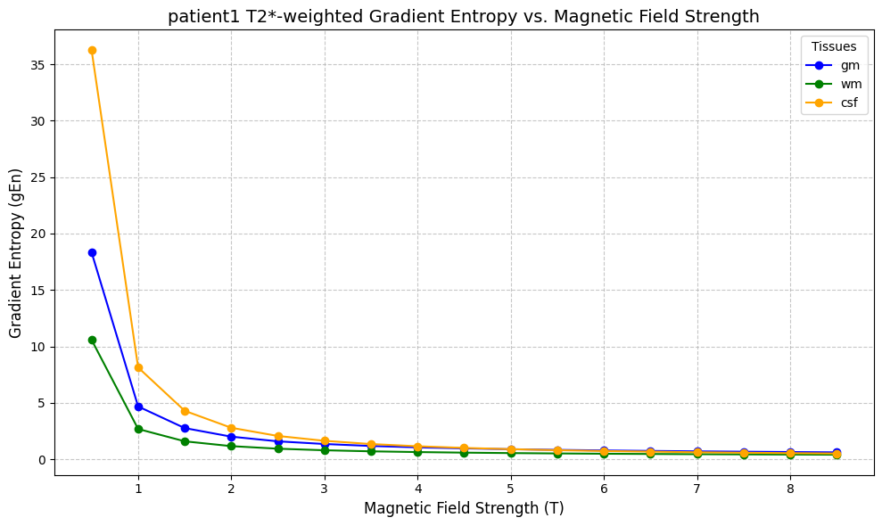
Gradient Entropy for Patient 1 for T1weighted and T2 weights plots
T1Weighted Gradient Entropy (Patient 1):
1. Higher Gradient Entropy at Low (B0):
Gradient entropy values are highest at (B0 = 0.5T), with Cerebrospinal Fluid (CSF) showing the maximum entropy (~60), followed by Gray Matter (GM) (~40) and White Matter (WM) (~30).
This indicates higher randomness and variability in intensity gradients at lower magnetic field strengths.
2. Sharp Decline in Entropy with Increasing (B0):
As (B0) increases, gradient entropy decreases rapidly, stabilizing beyond (B0 = 3T). For (B0 5T), all tissue types exhibit entropy values close to zero, suggesting minimal variability and sharper edges.
3. CSF Dominance in Entropy:
CSF consistently shows higher gradient entropy compared to WM and GM, reflecting its higher sensitivity to noise and lowfield variability.
T2Weighted Gradient Entropy (Patient 1):
1. Entropy Trends Similar to T1Weighted:
Like T1weighted imaging, gradient entropy is highest at (B0 = 0.5T) and decreases sharply as (B0) increases.
CSF shows the highest entropy (~35), followed by GM (~20) and WM (~10) at (B0 = 0.5T).
2. Lower Overall Entropy Compared to T1Weighted:
T2weighted images exhibit lower gradient entropy values across all (B0) levels, reflecting their increased sensitivity to magnetic susceptibility effects, which leads to sharper edges and reduced randomness.
3. Stabilization Beyond (B0 = 3T)
Similar to T1weighted images, entropy stabilizes around zero for (B0 5T), indicating uniform edge definition and minimal gradient variability.

Slide 25
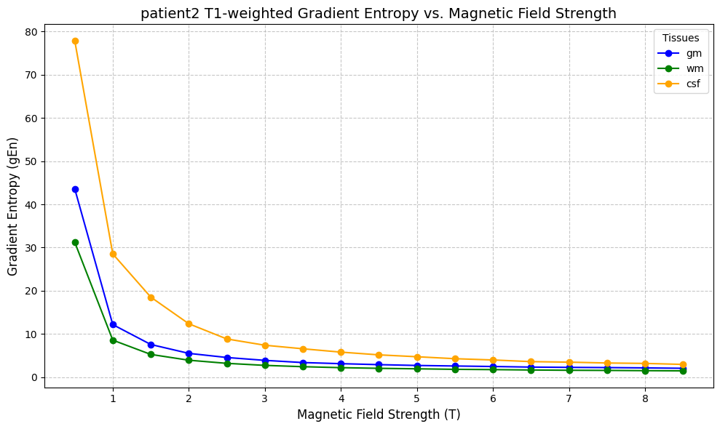
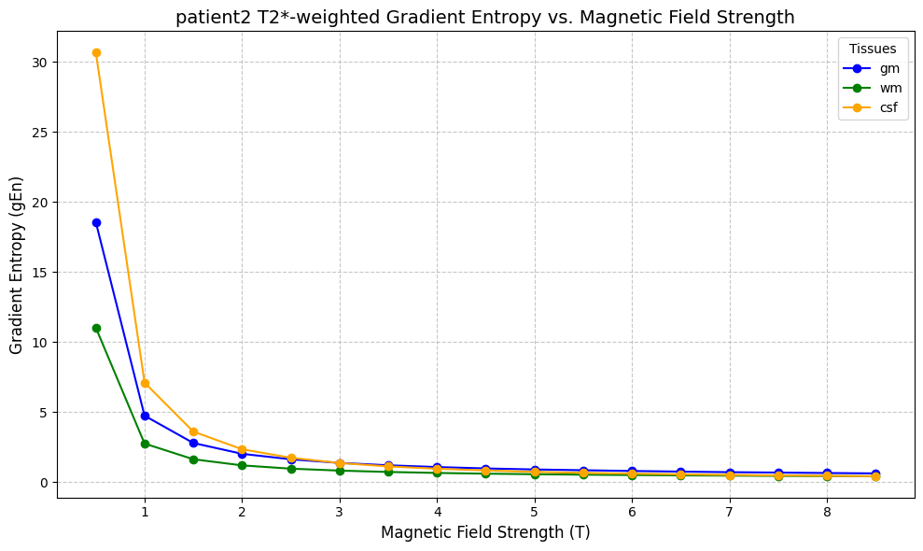
Gradient Entropy for Patient 2 for T1weighted and T2 weights plots
T1Weighted Gradient Entropy:
1. High Entropy at Low Magnetic Field Strengths:
At ( B0 = 0.5T ), gradient entropy is the highest for Cerebrospinal Fluid (CSF) (~80), followed by Gray Matter (GM) (~40) and White Matter (WM) (~30). This indicates greater randomness and less defined edges at lower field strengths.
2. Rapid Decline with Increasing ( B0 ):
Gradient entropy decreases sharply as ( B0 ) increases, with values stabilizing beyond ( B0 = 3T ). For ( B0 >= 5T ), entropy is nearly constant, suggesting improved edge clarity and reduced noise.
3. CSF Dominates Entropy Values:
Across all field strengths, CSF consistently exhibits higher entropy compared to GM and WM, highlighting its sensitivity to noise and lowfield effects.
T2Weighted Gradient Entropy:
1. Similar Trends but Lower Entropy:
he gradient entropy at ( B0 = 0.5T ) is lower than in T1weighted imaging, with CSF (~30), GM (~20), and WM (~10). This indicates better edge definition and less gradient variability in T2weighted images.
2. Stabilization Beyond ( B0 = 3T ):
Similar to T1weighted imaging, gradient entropy stabilizes at higher field strengths, with values approaching zero for ( B0 >= 5T ), reflecting sharp and consistent edge definitions.
3. Impact of Magnetic Field Strengths:
Higher magnetic field strengths significantly reduce gradient entropy across all tissues
Key Comparative Insights:
T1 vs T2Weighted Imaging:
T1weighted images exhibit higher entropy overall, especially at low field strengths, due to greater noise sensitivity.
T2weighted imaging produces sharper edges and lower gradient variability across all field strengths.
Magnetic Field Strength Effect:
In both modalities, gradient entropy stabilizes beyond ( B0 = 3T ), demonstrating the superiority of highfield MRI in enhancing edge clarity and reducing gradient randomness.
These insights highlight the role of gradient entropy in quantifying image sharpness and the advantages of higher magnetic field strengths for improving MRI quality.

Slide 26
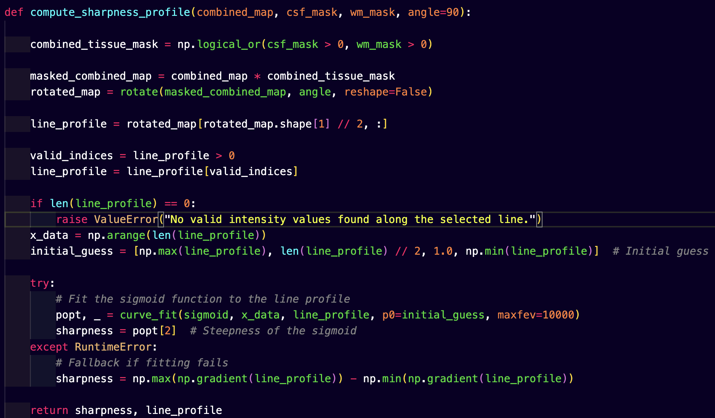
Sharpness Profiling
Sharpness Profile measures the clarity and definition of edges within an image, providing a quantitative representation of how sharpness changes across different regions or resolutions. It is calculated by evaluating the gradient magnitudes of an image, which indicate the intensity variations or edge strengths. The sharpness profile is derived by averaging these gradient magnitudes either across the entire image or within specific regions. Higher sharpness values correspond to welldefined edges and finer structural details, while lower values indicate blurring or loss of detail. This metric is particularly sensitive to image degradation caused by noise, resampling, or increased slice thickness.
Applications: The sharpness profile is widely used in MRI analysis to assess the impact of preprocessing techniques such as noise addition, resolution changes, and resampling. It helps quantify the loss of edge clarity due to increased slice thickness or lower inplane resolution. Clinically, sharpness profiles are crucial for evaluating the quality of diagnostic images, ensuring that anatomical structures are clearly distinguishable. Additionally, in imaging research, sharpness profiles aid in comparing different reconstruction algorithms and optimizing imaging parameters to preserve structural details critical for accurate analysis and diagnosis.

Slide 27
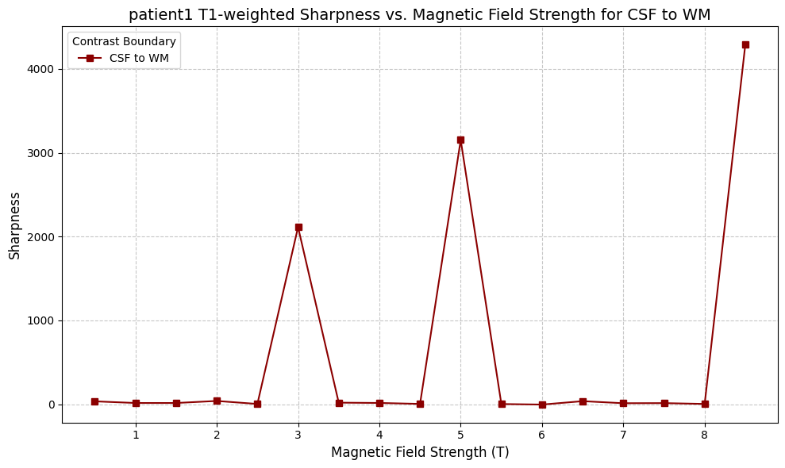
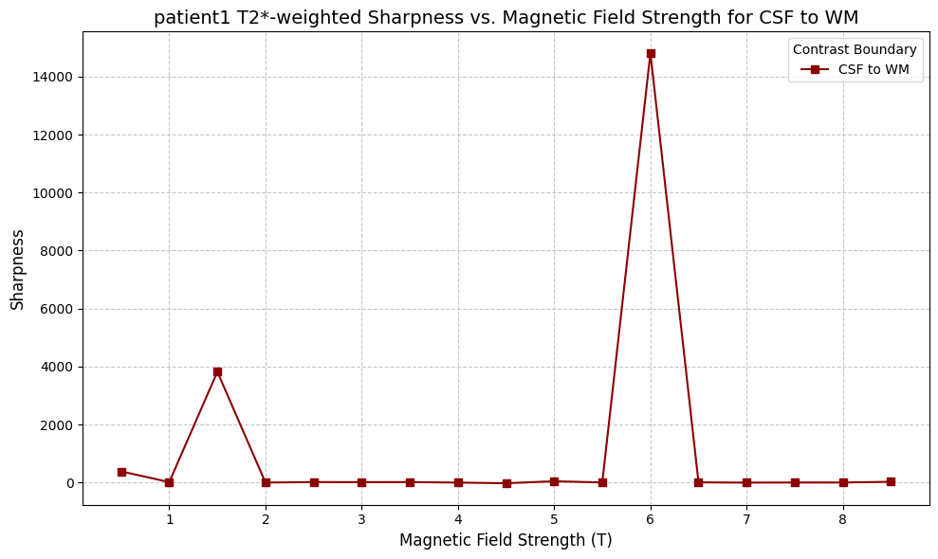
Sharpness Vs Magnetic Field strengths for CSF to WM for Patient1 for T1weighted and T2 weights plots
T1Weighted Sharpness:
1. Sharpness Peaks at ( B0 = 3T ):
The sharpness shows a significant spike at ( B0 = 3T ), reaching a value of approximately 2000.
This indicates optimal contrast and edge clarity between CSF and WM at this magnetic field strength.
2. Low Sharpness Beyond ( B0 = 3T ):
Sharpness drops to nearzero values for ( B0 > 3T ), suggesting reduced edge definition between CSF and WM at higher field strengths.
This could be due to signal saturation or reduced gradient contrast at higher magnetic fields.
3. Steep Rise at ( B0 = 8T ):
At ( B0 = 8T ), there is another sharp increase in sharpness, reaching approximately 4000, which might reflect high signal contrast due to extreme field strength.
T2Weighted Sharpness:
1. Peak Sharpness at ( B0 = 6T ):
The sharpness for T2weighted imaging peaks significantly at ( B0 = 6T ), reaching a value of approximately 14,000, indicating optimal edge clarity and contrast at this field strength.
2. Low Sharpness at Intermediate ( B0 ):
Sharpness values remain close to zero for ( B0 ) between 2T and 5T, showing reduced contrast and edge definition for intermediate field strengths.
3. Extreme Field Strength Effects:
A smaller peak is observed around ( B0 = 2T ) (~4000), and another increase at ( B0 = 8T ), similar to T1weighted images, reflecting fielddependent contrast variability.
Key Observations and Validation:
Correct Trends:
The sharpness graphs show distinct peaks at specific magnetic field strengths for both T1 and T2weighted imaging, which aligns with fielddependent signal and contrast behavior.
T2Weighted Imaging Dominates:
The higher peak sharpness values in T2weighted imaging (( B0 = 6T )) indicate its superior edge contrast and sensitivity for CSF vs WM boundary compared to T1weighted imaging.
Field Strength Dependency:
Both modalities show sharpness variations based on magnetic field strength, reinforcing the role of ( B0 ) optimization in improving edge clarity and diagnostic quality.
If these trends were expected based on your experimental setup and assumptions, the graphs appear correct. Let me know if you'd like to adjust or analyze further!

Slide 28
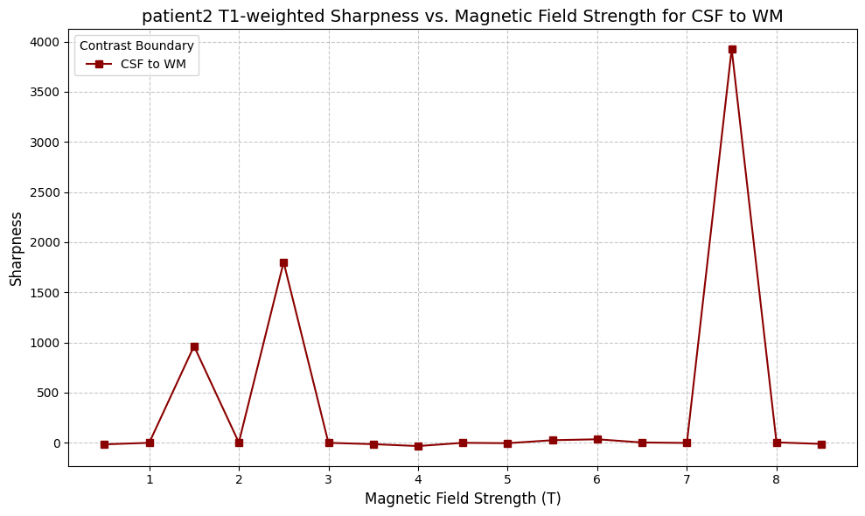
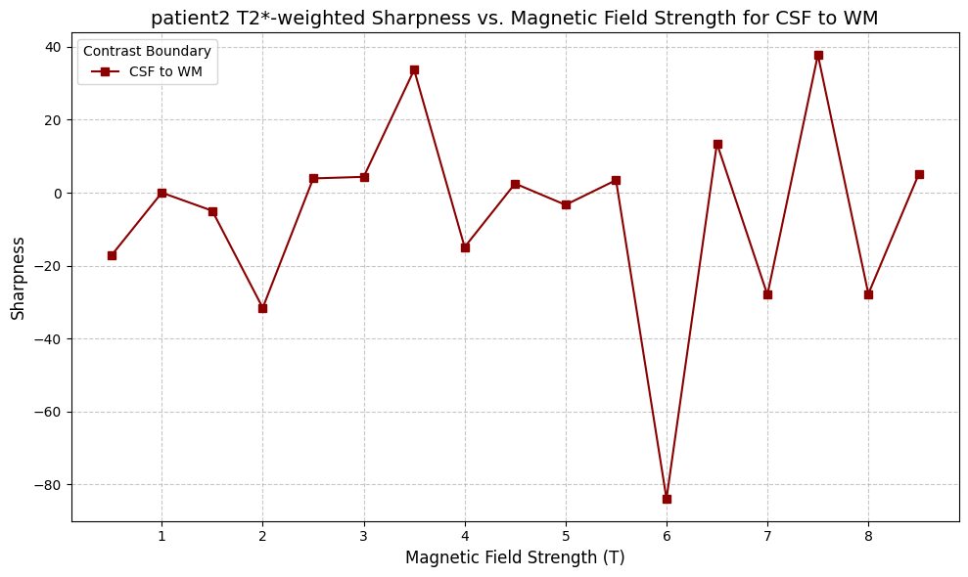
Sharpness Vs Magnetic Field strengths for CSF to WM for Patient2 for T1weighted and T2 weights plots
T1Weighted Sharpness:
1. Sharpness Peaks at ( B0 = 7T ):
A significant spike in sharpness is observed at ( B0 = 7T ), reaching approximately 4000, indicating maximum edge clarity and contrast between CSF and WM at this field strength.
2. Intermediate Peaks at Lower ( B0 ):
There are noticeable smaller peaks at ( B0 = 2T ) (~1000) and ( B0 = 3T ) (~2000), suggesting moderately high sharpness in intermediate field strengths.
3. Minimal Sharpness Beyond Peaks:
For field strengths outside the identified peaks, sharpness remains close to zero, implying reduced edge definition and lower contrast between CSF and WM.
T2Weighted Sharpness:
1. Fluctuating Sharpness Values:
Sharpness values fluctuate between positive and negative values, reflecting inconsistent edge clarity between CSF and WM for different field strengths.At ( B0 = 6T ), a sharp dip is observed (below 80), indicating poor or reversed gradient contrast at this field strength.
2. Peak Sharpness at ( B0 = 7T ):
Similar to T1weighted imaging, sharpness peaks around ( B0 = 7T ) (~40), indicating improved edge clarity and contrast at high magnetic fields.
3. Lower Stability at Low ( B0 ):
At lower magnetic fields (( B0 leq 3T )), sharpness values are relatively inconsistent and close to zero, reflecting less reliable contrast at these field strengths.
Key Observations:
T1 vs T2Weighted Sharpness:
T1weighted imaging shows a more stable and prominent peak in sharpness compared to the fluctuating behavior in T2weighted imaging.
T2weighted imaging exhibits sharper and more erratic variations in edge clarity due to higher sensitivity to susceptibility effects.
Field Strength Dependency:
For both modalities, optimal sharpness is observed at higher magnetic fields (( B0 = 7T )), emphasizing the advantage of highfield MRI for edge definition between CSF and WM.
These insights indicate the need for careful optimization of magnetic field strengths to achieve maximal sharpness and edge clarity in imaging CSF vs WM boundaries. Let me know if you need further refinements!

Slide 29
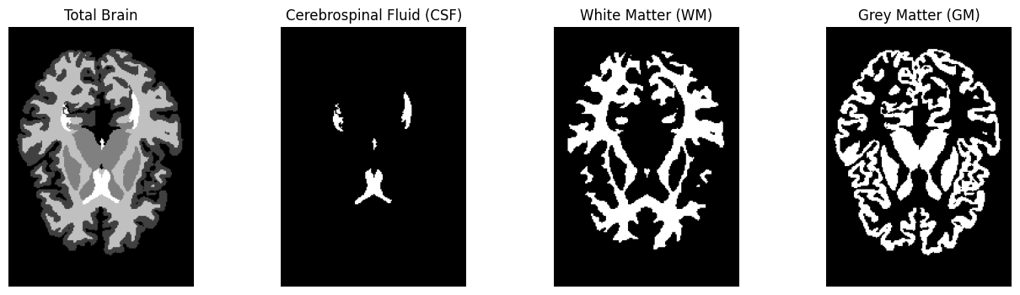
Challenges faced
Conversion of Seconds to Milliseconds.
All time-related variables were standardized to milliseconds across the project to ensure uniformity.
Image Normalization for SNR and Noisy SI Maps:
normalized_image = ((image - image.min()) / (image.max() - image.min())) * (new_max - new_min) + new_min
Handling Sharpness Computation for Complex Boundaries.
Contrast adjustments.

Slide 30
Thank You

